Slide 1

tinyNX33U Module v1:
Early Access Documentation
Venkat Rangan

Slide 2
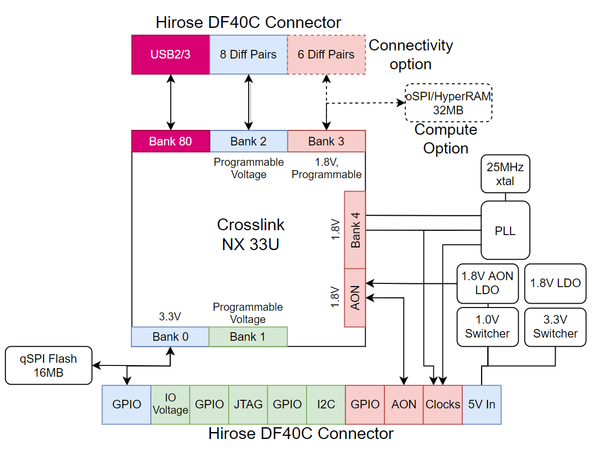
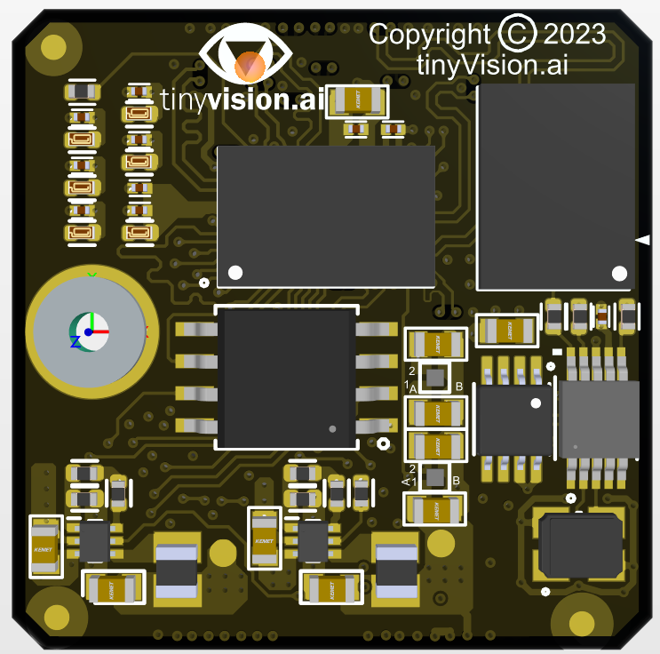
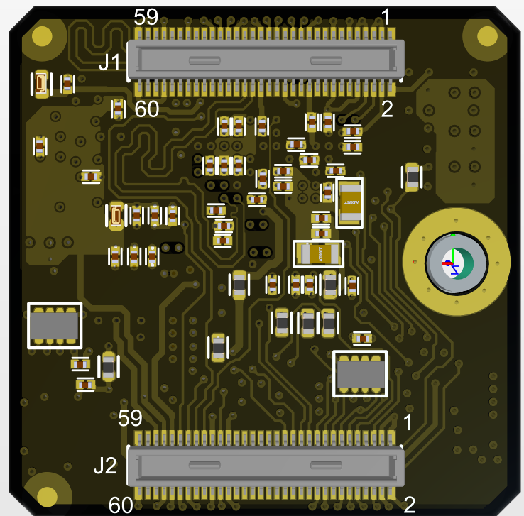
What is it?
25.4mm x 25.4mm x 4.5mm module, Commercial temperature
2x Hirose high density DF40C 60 pin connectors
Proven on 1000’s of SoM’s in the field in high vibration environments
Spare pins for future proofing
2 flavors:
Connectivity: 14 diff pairs, no SSRAM
Compute: 8 diff pairs, 32 MB oSPI/HyperRAM @ <0.5GBps
Interfaces
3x fully programmable clocks
GPIO, I2C, field updates through FPGA or direct flash programming
GPIO voltage is programmable
Firmware/RTL
uPython for control path on RISCv
No code, graphical RTL generator with large # of IP blocks (under development)
Development Boards
Baseboard for programming/debug
Camera and other expansion boards available
NX33U
SRAM
Flash
Clock
Power

Slide 3
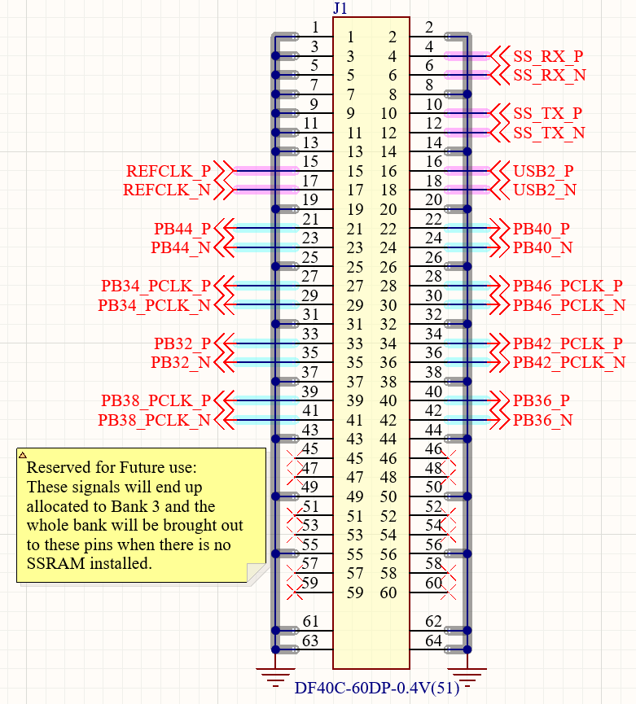
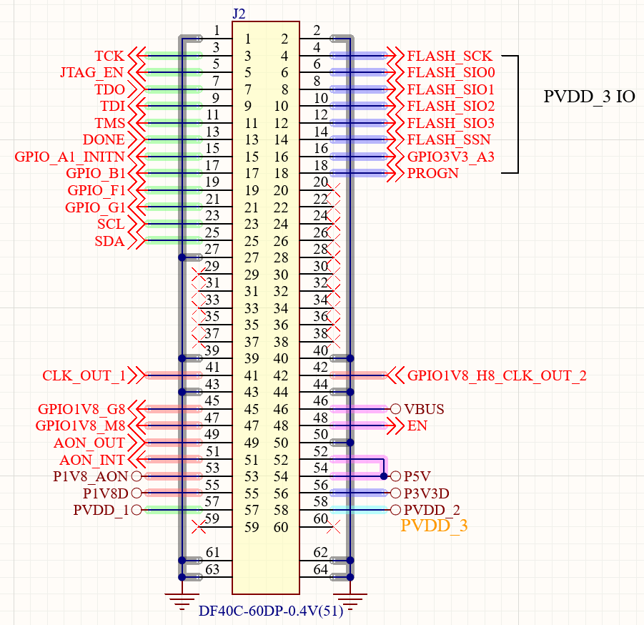
SoM Interface
2x Hirose DF40C 60 pin connectors
Low cost, high performance, easily available
3mm mounting hole for mechanical stability

Slide 4
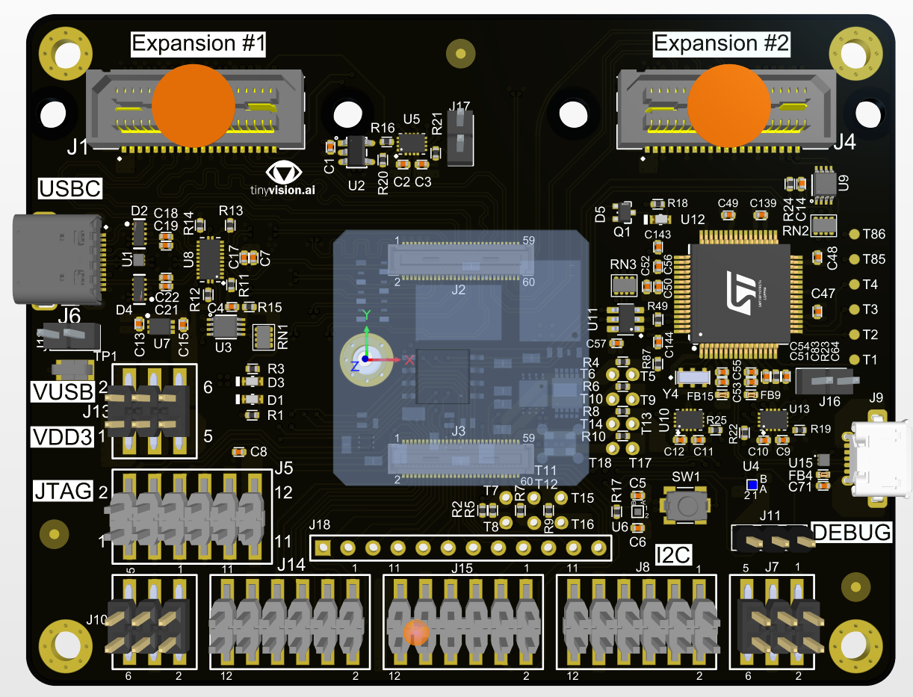
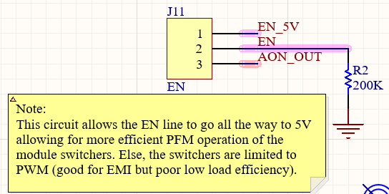
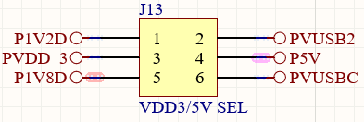
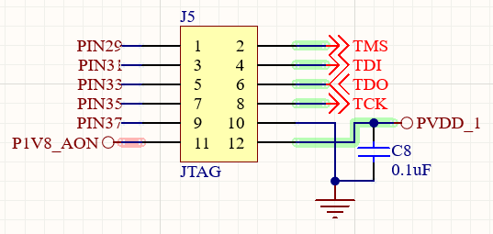
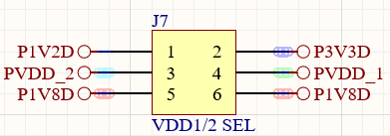
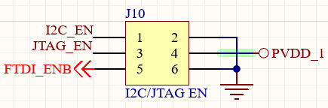
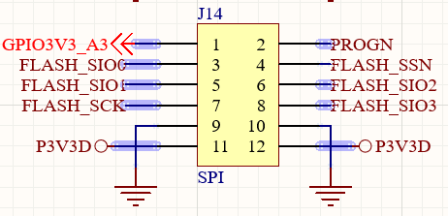
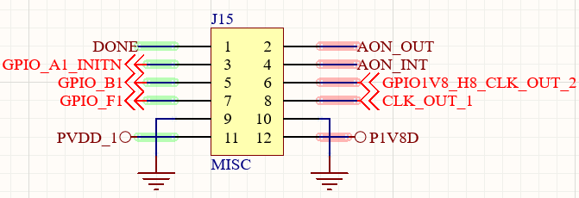
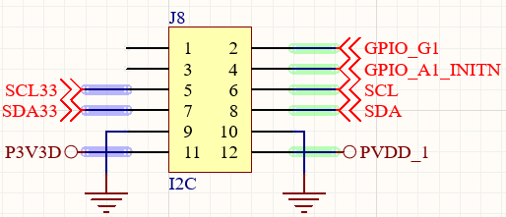
Baseboard
GPIO_DIR/CLK_EN
SoM Enable
LED: DONE
USBC
USBC I2C Enable
LED: 3.3V
FTDI Disable
LED: 5V
Debug USB
INITn

